Slide 1
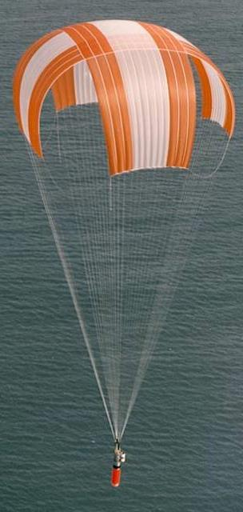
Flight
Parachute Opening Loads
LabRat Scientific
© 2019

Slide 2
Parachute design is much more complex than just selecting a parachute shape and sizing the canopy. A parachute must be able to withstand potentially heavy loads during deployment.
The designer must select the proper materials, design the stitching techniques to hold things together, and incorporate ways to minimize the opening loads.
It’s not good enough to just build the parachute super strong because this will probably result in a parachute that is too bulky and too heavy.
Generally speaking, the biggest design consideration is the Opening Shock Load because it will drive the required strength of the system…

Slide 3
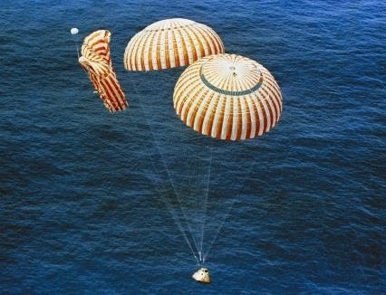
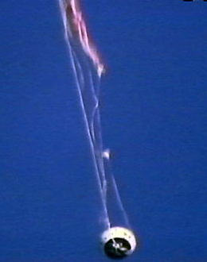
The opening shock can be so high that the parachute will tear to shreds or rip away from the payload?

Slide 4
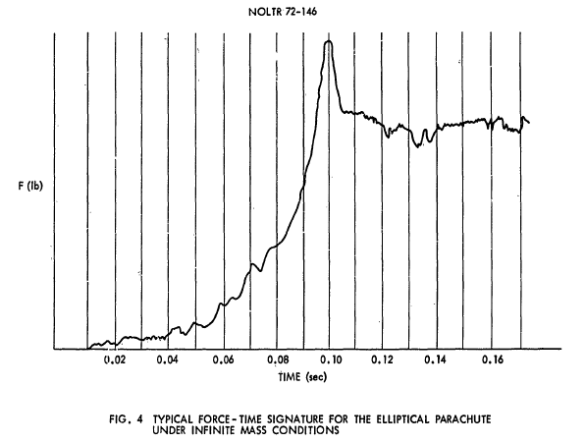
Parachute Opening Load
This is the “opening shock” - the time when the parachute is most likely to fail…
Steady State Drag
“Infinite Mass” is a condition where the descending body does not decelerate when the chute is deployed. This is what happens when a chute is deployed in a wind tunnel (the air speed does not decrease…).

Slide 5
What causes the large Opening Load

Slide 6
What causes the large Opening Load

Slide 7
What causes the large Opening Load
As the parachute canopy begins to open it starts scooping up air that “is at rest”. This “resting” air has inertia and thus wants to resist being accelerated…

Slide 8
What causes the large Opening Load
The moving payload body also has inertia and it wants to resist being decelerated… These opposing inertial states cause the large opening force to exist in the system.

Slide 9
What causes the large Opening Load
Once the captured bubble of air is accelerated and the system reaches a steady state condition the inertial imbalance becomes greatly diminished and the loads in the system decrease.

Slide 10
Estimating Parachute Opening Loads
The Handbook of Astronautical Engineering (Koelle) provides an equation for estimating parachute opening shock:
Opening Shock = ½ x Air Density x Vel² x Cd x Area x X₀ x X₁
Standard Drag Equation
X₀ = Opening Load Shock Factor (dependent on chute shape)
X₁ = Opening Shock Decrease Factor (dependent on operating conditions)
Factors X₀ and X₁ are determined experimentally…

Slide 11
Opening Load Factors
X₀ = Opening Load Shock Factor
This factor is driven by the shape and porosity of the parachute canopy.
Flat Circular Parachute: X₀ = 1.7
Square Parachute: X₀ = 1.7
Cross Parachute: X₀ = 1.3
Note: Data on full-scale parachute Opening Shock Factors is very limited

Slide 12
Opening Load Factors
X₁ = Opening Shock Decrease Factor
This factor is driven by the canopy loading, canopy filling time, velocity, and altitude during parachute ejection. The range for X₁ for full-scale parachutes is as follows:
1.0 > X₁ > 0.02
Infinite Mass Conditions
Large Drag and Low Weight Conditions
Infinite mass is a condition where the system velocity does not change once the parachute is deployed. Examples include wind tunnel tests and drop tests of small parachutes with heavy suspended loads. Small values of X₁ are associated with systems that slow down very quickly once the chute is deployed such as in large, lightly loaded parachutes deployed at low velocities or light weight model rockets.

Slide 13
Parachute Opening Load
Experiments

Slide 14

Opening Load Test Apparatus
The Load Cell is attached to the free falling Test Block. The Load Cell measures the parachute opening force.
Test Parachute
The Test Parachute is connected to the load pin on the Load Cell
Load Cell
Test Block
The Test Block is dropped from several different heights and allowed to freefall prior to parachute extraction in order to generate various parachute extraction velocities.
Guide Wires
Test Stand

Slide 15
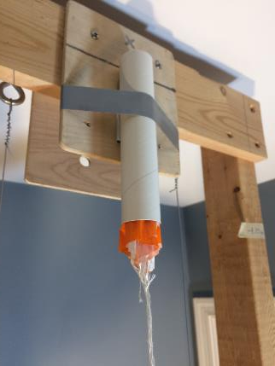
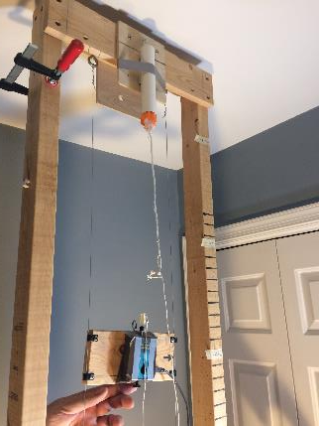
Opening Load Test Apparatus
Test Parachute in the Deployment Tube
Ready for drop test. Slack in string is to allow for predetermined freefall before chute extraction.

Slide 16
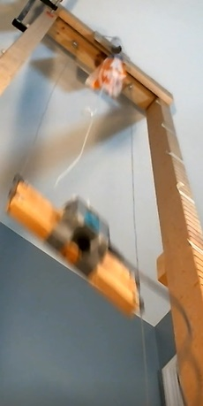
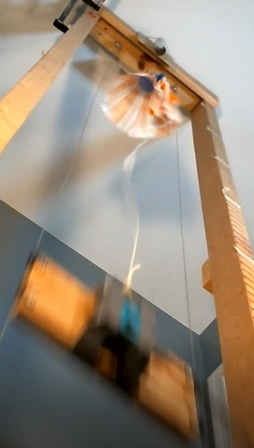
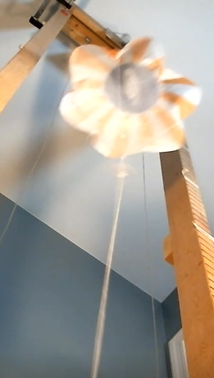
Parachute Opening Sequence
Parachute Extraction
Parachute Inflation
Parachute Full Open

Slide 17
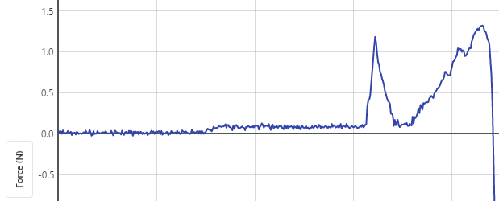
Drop Test Data
Parachute Fully Open
Representative Data Sample (0.5 m freefall drop)
1.32 N
Parachute Extraction from Storage Tube
Parachute Opening
0.302 sec
0.622 sec
Free Fall of Test Weight
(0.32 sec)

Slide 18
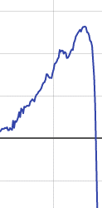
Drop Test Data
Drag decreasing towards steady state drag
Drag as the parachute canopy opens
The system does not have sufficient time (vertical distance) to allow the chute to reach steady state drag level.
Test Rig hitting the ground
Parachute Opening Time
(0.154 sec)

Slide 19
Drop Test Data

Slide 20
Drop Test Data
Extraction Velocity (m/sec) | Opening Load (N) | Steady State Drag (N)
2.25 | 1.05 | 0.27
3.14 | 1.46 | 0.52
4.4 | 1.88 | 1.02
5.19 | 2.08 | 1.42
The Steady State Drag is calculated by using the Extraction Velocity in the drag equation. The Opening Load is the maximum force that was measured during the drop tests. The difference in these load values represents the Opening Shock.

Slide 21
Calculating the Opening Load Shock Factor
The Opening Load Shock Factor (X₀) is calculated by dividing the measured opening load by the calculated steady stage drag.
Measured Opening Load
Opening Load Shock Factor (X₀) = -----------------------------------------
Calculated Steady State Drag
LabRat drop tests indicate that the Opening Load Shock Factor (X₀) is not linear for small model rocket parachutes and thus an equation must be established so that values can be estimated for cases not directly tested.

Slide 22
Establishing an Equation for X₀
Opening Shock = ½ x Air Density x Vel² x Cd x Area x X₀ x X₁
Since the tests were conducted under infinite mass conditions, the Opening Shock Decreasing Factor (X₁) is assumed to be 1.0.
Using a function in Excel, a polynomial curve fit was applied to the test data in order to generate an equation for estimating the Opening Shock Factor (X₀) for the small flat circular parachute used in the drop tests.

Slide 23
Estimating Opening Loads for Model Rockets
Use the following equation to estimate the Opening Load Shock Factor:
X₀ = ( 0.17 x (Rocket Velocity)² ) - ( 2.09 x (Rocket Velocity) ) + 7.7
Assume one of the following Opening Shock Decreasing Factors:
X₁ = 0.08 for a light weight model rocket
X₁ = 0.12 for a medium sized high-powered model rocket
X₁ = 0.20 for a heavy, high-flying high-powered model rocket

Slide 24
Sample Calculation
Calculate the opening load for a 50 cm diameter flat circular parachute on a light-weight model rocket flying at 10 m/sec when the parachute is deployed.
1. Calculate the Canopy Area (S):
Area = Pi x Radius² = 3.1416 x (0.25 m)² = 0.20 m²
2. Calculate Parachute Drag at Deployment:
Drag = ½ x Density x Velocity² x Cd x S = 0.5 x 1.225 x (10)² x 1.3 x 0.2
= 15.9 N
3. Calculate Opening Load Shock Factor (X₀):
X₀ = ( 0.17 x (Rocket Velocity)² ) - ( 2.09 x (Rocket Velocity) ) + 7.7
X₀ = ( 0.17 x (10)² ) - ( 2.09 x (10) ) + 7.7
X₀ = 3.8

Slide 25
Sample Calculation
4. Select an appropriate Opening Shock Decrease Factor (X₁):
X₁ = 0.08 Since we are analyzing a light-weight model rocket
5. Calculate the Opening Shock:
Opening Shock = Drag x X₀ x X₁
= 15.9 N x 3.8 x 0.08
= 4.8 N
This value is significantly lower than the “drag” calculated in Step 2 because the rocket is light weight and the system slows down extremely fast. While the deceleration will be high, the light weight rocket results in a small load… In contrast, a very heavy rocket with the same chute and deployment conditions would have an opening shock on the order of 12 N.

Slide 26
Reducing Opening Shocks

Slide 27
What can be done to minimize the opening loads?
1. Make the parachute open slower
2. Use a more porous canopy material
3. Use an apex vent
4. Make a shock absorbing system

Slide 28
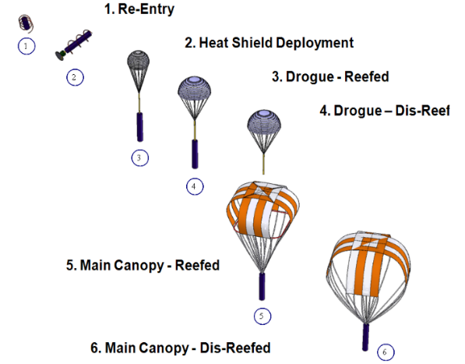
Canopy Area Control – Staging and Reefing
Staging is the technique of using multiple parachutes and opening them in a controlled sequence.
Reefing is the technique of holding the base of the parachute canopy partially close by a loop of rope. The rope is cut by pyrotechnic line cutter a few seconds after parachute opening.
While reefing is not practical in model rockets, staged recovery systems are routinely used in high-powered hobby rockets.

Slide 29
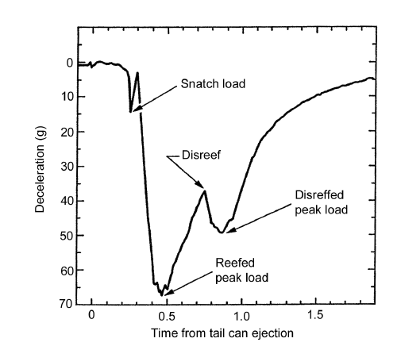
Reefed/Disreefed Parachute
This graph shows how the loads occur in “steps” as the result of reefing. The maximum deceleration ends up being less than an un-reefed system.
Representative load had the chute not been reefed

Slide 30
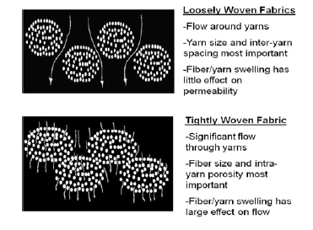
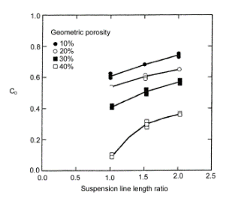
Permeable Materials
Also known as “porosity”
Allows more air to move through the canopy material and thus reduces the mass of air that needs to be accelerated during parachute opening.
Affects the following
  Drag Coefficient
  Stability (swinging)
  Inflation time
  Opening shock
Caution - If the canopy is too porous it may not open.

Slide 31
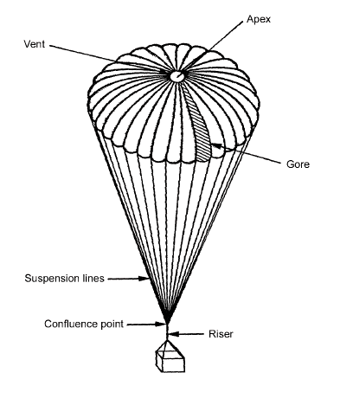
Apex Vent
The apex vent allows air to escape from inside the canopy, resulting in lower internal pressure.
Less internal pressure will alter inflated shape of the canopy and thus the drag area.
If more air is allowed to pass through the apex hole the air mass that needs to be accelerated is decreased.
Caution - If the vent is too large, the internal pressure will be to low and the canopy may not inflate.

Slide 32
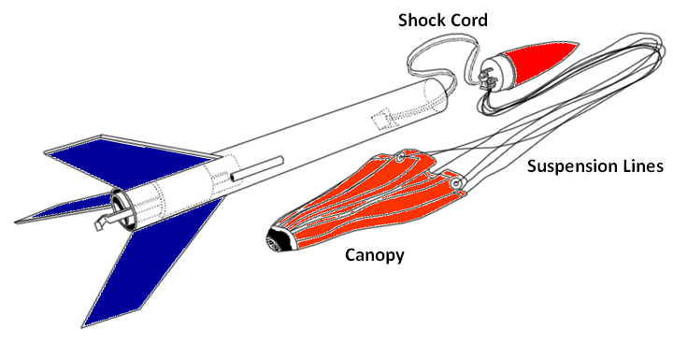
Shock Absorption
Elastic Band
A large rubber band that stretches and dissipates energy…
A heavier elastic cord could be used for bigger rockets. Generally, the longer the better to give more stretch….

Slide 33


Shock Absorption
Simple Cord
The cord provides no elasticity and thus no shock attenuation.

Slide 34
Shock Absorption
Slip Loops
Loops of string tightly tied around the lanyard loops.

Slide 35
Shock Absorption
Slip Loops
The line tension causes the lanyard to pull through the string ties which dissipates energy (load).

Slide 36
Shock Absorption
Break Loops
Thread sewn through the lanyard. The thread has to break to release the loops.

Slide 37
Shock Absorption
Break Loops
Snap!
Snap!
As the thread ties “snap” they dissipate energy…

Slide 38
Shock Attenuation Experiments

Slide 39
Shock Attenuation Testing
A simple static pull test is not adequate to assess “snatch loads” and “shock attenuation” because shock loading is a short duration “dynamic” element
  It needs to have a “snatch” element rather than just a simple “static” load

Slide 40
Shock Attenuation Test Apparatus
Load Cell
Simple drop tests can be used to assess various shock attenuation techniques.
Shock attenuation device being subjected to test
In this test configuration, the load cell it attached to the top of the Test Stand.
Test Block
A freefalling Test Block is used to jerk on the test material.
Guide Wires
Trial-and-Error tests on a stiff cord are conducted to determine a free fall drop height that gives a peak load cell reading that is equal to the anticipated opening load.
Test Stand

Slide 41
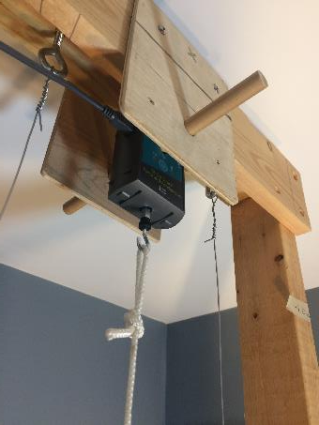
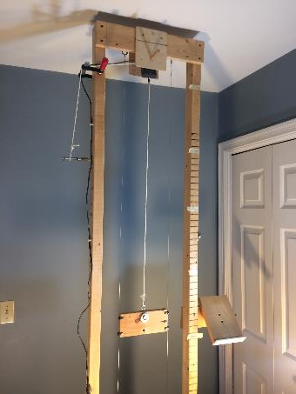
Shock Attenuation Test Apparatus
Force Sensor
Test Material
Drop Weight

Slide 42
Shock Attenuation Test Results
The example calculation provided on an earlier slide generated an opening load estimate of 4.8 N. The experimental freefall height was determined by trying various drop tests using the stiff cotton string. A 5 cm drop height resulted in a 5.4 N test shock load.
An elastic band was tested using the same 5 cm drop height and drop mass. The difference in the shock load represents the shock attenuation.

Slide 43
Shock Attenuation Test Results
This side-by-side comparison shows how the shock load is significantly reduced by incorporating an elastic band into the parachute train.
Notice that while the load is lower, the action time is quite a bit longer for the elastic band.

Slide 44
Additional tests at higher opening loads were conducted to compare the performance of the following techniques:
      Stiff Cord
      Break Loops
      Large Elastic Band

Slide 45


Initial Snatch
This configuration provides no shock attenuation.
This is a test of a cotton cord that had very little elasticity and thus very little shock attenuation. It represents the worst-case scenario.
400 samples/sec
First Bounce
Second Bounce

Slide 46

This drop test utilized the tied restraint loops. It resulted in multiple load pulses as each loop pulled tight.
The maximum load was 12 N compared to 40 N using the simple cord.
400 samples/sec

Slide 47

400 samples/sec
This drop test utilized an elastic band which is typical for a simple model rocket.

Slide 48
400 samples/sec
Rigid Cord
The elastic band stretched out the reaction time and resulted in the lowest snatch force acting on the system.
0.06 Sec
0.3 Sec
0.8 Sec

Slide 49
Experiment Suggestions
Effect of Apex Vent size on opening loads
  Build several canopies with identical area and cut various size holes at the apex.
Effect of canopy porosity on opening loads
  Build several canopies with identical areas and use a paper punch to perforate the canopies with different number of holes. Calculate the total area of the holes in each canopy and calculate a porosity ratios (R_{p} = Total Hole Area / Canopy Area)
Effect of elastic band length of shock attenuation

Slide 50

Questions?

